Slide 1
BLOOD DONATION
Dana Mansour
Jumana Ibrahim
Marwah Sameer
Sarah Khalid
Artificial Intelligence
23164402-4
Dr. Mashael Al-Luhaybi
7 February 2023

Slide 2
CONTENTS
01
02
03
04
05
KNN
Conclusion
Neural Networks
Abstract
Comparing with KNN
Code screen shots
Introduction

Slide 3
1ST Abstract
After completing the artificial intelligence course, we are able to build an integrated project, we have chosen the medical field in blood transfusion prediction.
We will explain implemented idea and the algorithm by which we implemented the project.
We will explain the code and the results.

Slide 4
2ST Introduction
There are many things we need as humans to survive. One of them is blood, especially when a person is exposed to an accident, surgery, or any health situation that makes a person need quick blood compensation. In order to help these people, it would be good to have a way to predict the people who are most likely to donate blood to them.

Slide 5

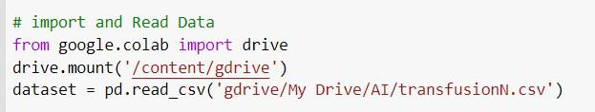


3ST KNN

Slide 6

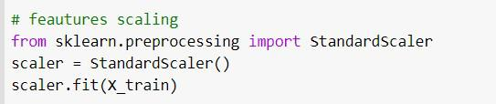

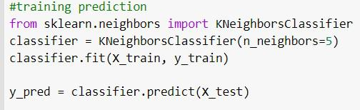
KNN

Slide 7
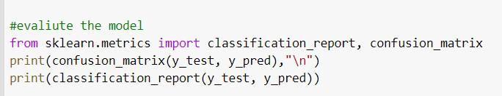
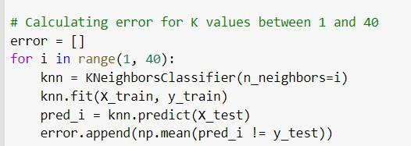
KNN

Slide 8
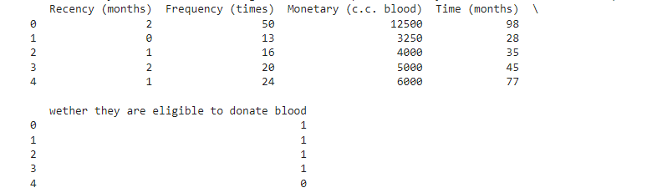
KNN OutPut

Slide 9
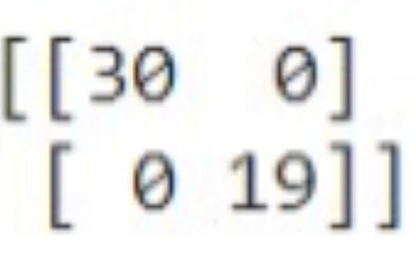
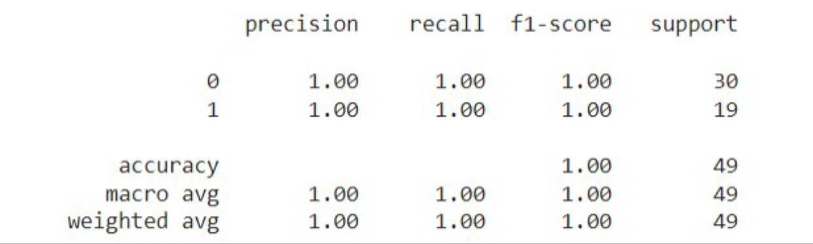
KNN OutPut

Slide 10
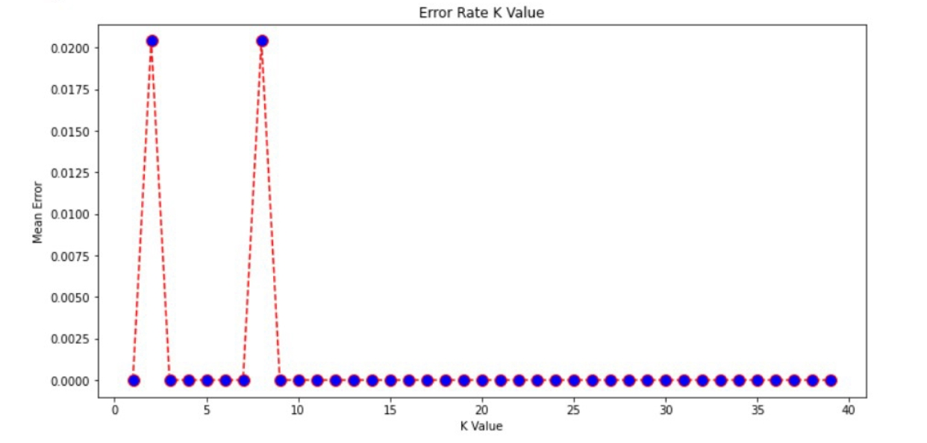
KNN OutPut

Slide 11
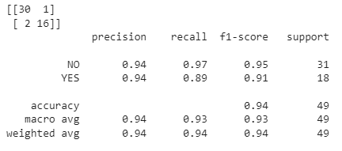
04
Neural Networks OutPut

Slide 12
5ST Conclusion
Building an intelligent system capable of predicting people who will or will not be able donate blood. When identifying people who donate the blood is needed to contact them, through this project we have integrated Artificial Intelligence in the field of medicine and helping people revive lives.

